Slide 1

CRIME RATE PREDICTION IN US

Slide 2

Introduction
this project conducts an in-depth investigation into the dataset "US_Crime_Rates_1960_2014“
The research aims to analyse historical trends in crime, establish correlations between various crime categories, and develop a predictive model for predicting crime rates in the future

Slide 3

Objectives
Crime Trend Analysis: Discover historical crime patterns and trends from 1960 to 2014, providing the basis for informed decision-making
Correlation Analysis: Establish relationships between different crime categories to reveal simultaneous trends and improve understanding
Crime Rate Prediction: Develop predictive models using linear interpolation to predict future crime rates and enable proactive resource allocation
Alert System Implementation: Create an alert system to identify potential anomalies in projected crime rates and provide a real-time tool for law enforcement planning and intervention

Slide 4

Data Collection
The dataset, "US_Crime_Rates_1960_2014," sourced from Kaggle, serves as the primary data repository
It includes crime statistics from 1960 to 2014, encompassing various categories such as total crimes, violent crimes, and property crimes
The dataset comprises information on crime rates per 100,000 inhabitants for each year

Slide 5

Data Analysis Methods
Alert System: An alert system is implemented to notify law enforcement when predicted crime rates surpass predefined thresholds
Data Preprocessing: Load the dataset using Pandas, handle missing values, and conduct basic data cleaning
Exploratory Data Analysis: Explore the dataset's statistical properties and visualize crime trends over the years
Outlier Detection: Calculate z-scores to identify and remove outliers, ensuring the accuracy of subsequent analyses
Correlation Analysis: Visualize the correlation matrix using Seaborn to identify potential patterns among crime categories
Crime Rate Prediction: Implement linear interpolation to predict crime rates for future years, enhancing the dataset's temporal coverage

Slide 6
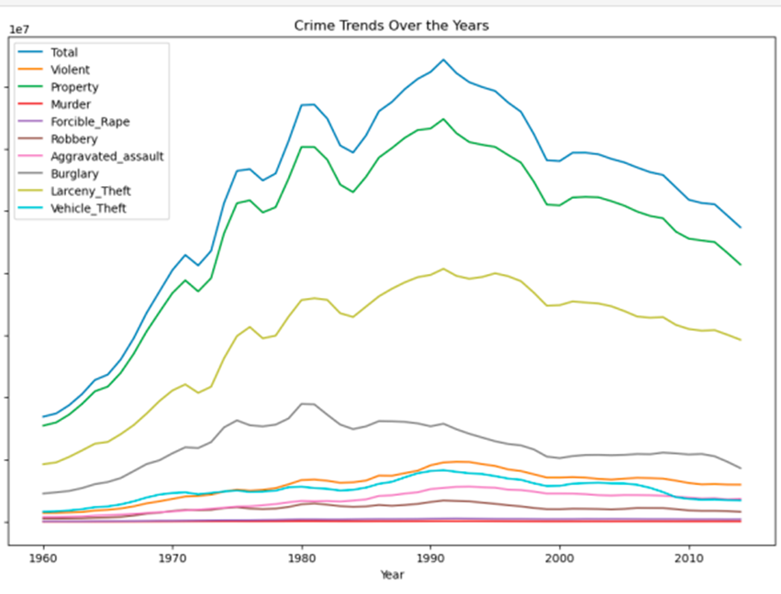
Crime trend over the years
1980s-1990s - Peak and Decline: The late 1980s to the early 1990s marked a peak in crime rates, particularly in violent crimes
The mid-1990s saw a significant decline in crime rates, attributed to various factors, including improved policing strategies
Predictive Insights : Predictive modeling suggests a potential increase in total crime rates, with a focus on specific categories like forcible rape and aggravated assault

Slide 7
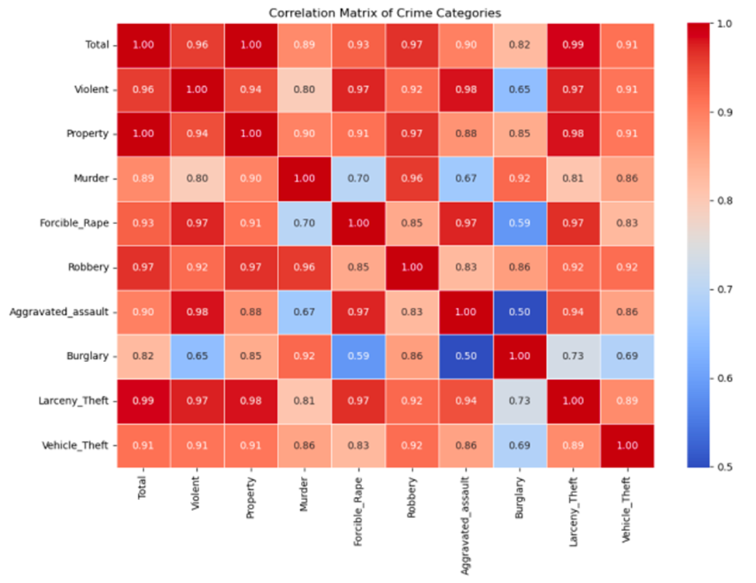
Correlation of Crime Categories
The correlation matrix provides insights into the relationships between different crime categories, offering a comprehensive view of their interdependencies
In this analysis, crime categories include Total, Violent, Property, Murder, Forcible Rape, Robbery, Aggravated Assault, Burglary, Larceny Theft, and Vehicle Theft
Property Crimes: Property crimes are expected to have a positive correlation with Burglary, Larceny Theft, and Vehicle Theft, reflecting their commonality in crime patterns

Slide 8
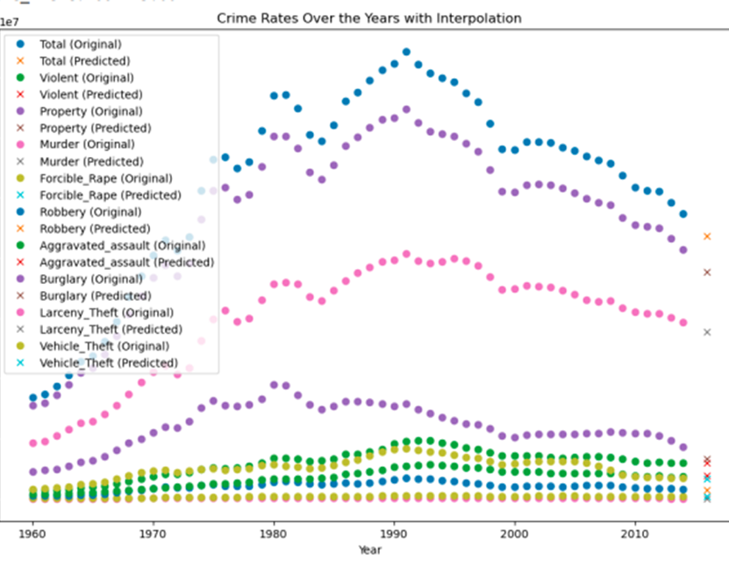
Prediction with Alert
The predicted crime rates for 2018 suggest potential areas of concern and priorities for law enforcement and policymakers
The analysis focuses on the predicted values and the identified categories requiring increased attention: Overall Crime Rate: The predicted total crime rate for 2018 is 7,977,300, indicating a significant volume of criminal activities
Specific Crime Categories: Violent Crimes : The high predicted number of violent crimes highlights the need for targeted strategies to address violent offenses, ensuring public safety
Property Crimes: Property Crime Total : The predicted property crime rate is notably high, necessitating attention to burglary, larceny theft, and vehicle theft

Slide 9
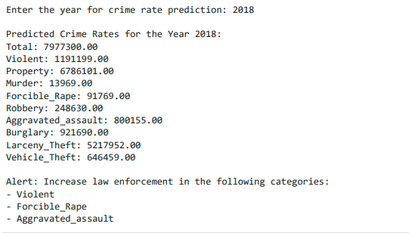
Prediction with Alert
Resource Allocation: The predictions provide actionable insights for resource allocation, enabling law enforcement agencies to prioritize efforts based on the expected prevalence of different crime types
This analysis serves as a valuable tool for law enforcement agencies and policymakers to develop targeted strategies, allocate resources effectively, and implement preventive measures, ultimately contributing to enhanced public safety

Slide 10

Key Findings
Elevated violent crime rates and specific categories like forcible rape and aggravated assault require heightened attention
In summary, this project not only provides a comprehensive analysis of historical crime trends but also equips stakeholders with actionable insights for proactive and targeted interventions
The findings contribute to the ongoing discourse on public safety, emphasizing the pivotal role of data-driven approaches in fostering secure and thriving communities

